Slide 1
HOW TECHNOLOGY HAS CHANGED MARKETS
Bitcoin and Cryptocurrency
DAY 1/2

Slide 2
What is an Arbitrageur?
In nearly all instances, the cause of arbitrage is on the basis of private information known by the arbitrageur, and ex-post facto (having executed the trades) can boast of the discovery of those inefficiencies, maybe 10-years later.
For example, a “would be” arbitrageur may use information about an impending takeover to buy up a company's stock and profit from the subsequent price appreciation. Which is known as “merger arbitrage” and is not in any sense a true “Arbitrage”.
Arbitrage generally is the concept of purchasing an identical financial vehicle at a lower price than all other market participants.
Notes:
Here is a short background of my involvement as a market-maker and arbitrageur for the last decade or so.

Slide 3
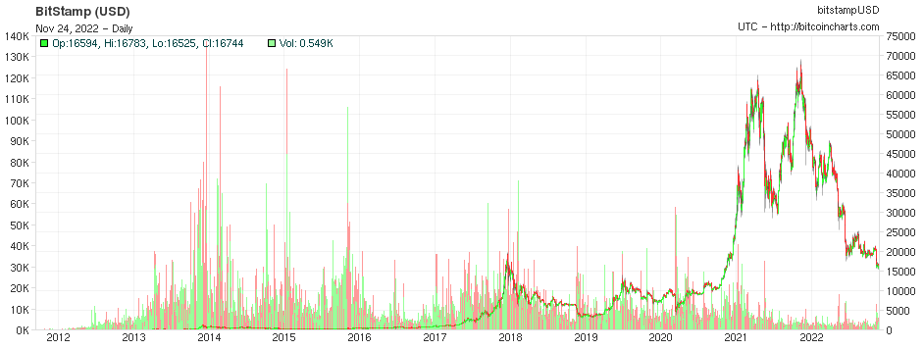
Notes:
In 2014-2015 I coded and deployed a Bitcoin miner and mined about two coins in roughly two months. This of course, was when bitcoin was valued at roughly $350/BTC

Slide 4
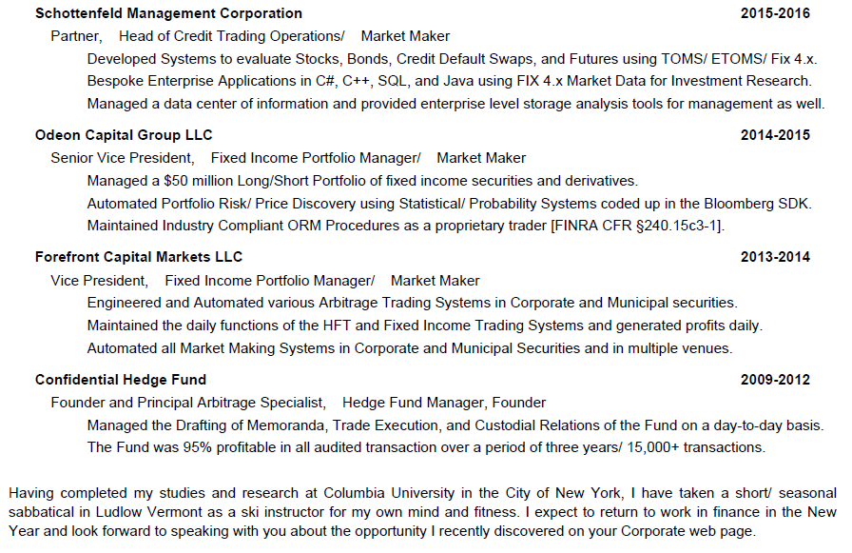
Notes:
Here is a short background of my involvement as a market-maker and arbitrageur for the last decade or so.

Slide 5
What is an Arbitrageur?
An arbitrageur is a type of investor who attempts to profit from market inefficiencies.
These inefficiencies can relate to any aspect of the markets, whether it is price, dividends, or regulation. The most common form of arbitrage is price.
Arbitrageurs exploit price inefficiencies by making simultaneous trades that offset each other to capture risk-free profits.
An arbitrageur would, for example, seek out price discrepancies between stocks listed on more than one exchange by buying undervalued shares on one exchange and selling short an equal number overvalued shares on another exchange.
- The goal is to capture risk-free profits as the prices on the two exchanges converge, and in most cases an arbitrageur, upon discovery, will cause those prices to disappear (momentarily) and re-calibrate to what most people understand as the efficient market hypothesis.
Notes:
Here is a short background of my involvement as a market-maker and arbitrageur for the last decade or so.

Slide 6
What is an Arbitrageur?
In nearly all instances, the cause of arbitrage is on the basis of private information known by the arbitrageur, and ex-post facto (having executed the trades) can boast of the discovery of those inefficiencies, maybe 10-years later.
For example, a “would be” arbitrageur may use information about an impending takeover to buy up a company's stock and profit from the subsequent price appreciation. Which is known as “merger arbitrage” and is not in any sense a true “Arbitrage”.
Arbitrage generally is the concept of purchasing an identical financial vehicle at a lower price than all other market participants.
Notes:
Here is a short background of my involvement as a market-maker and arbitrageur for the last decade or so.

Slide 7
What is an Arbitrageur?
Arbitrage generally is the concept of purchasing an identical financial vehicle at a lower price than all other market participants.
A true arbitrageur is also aware of the demand for the financial vehicles at a higher price at the time he/ she is purchasing the instrument, whether it be a stock, bond, crypto contract, a swap or an actual vehicle – there must be 100% certainty of a cash (liquid) buyer at the instant he/ she is buying the vehicle.
Notes:
Here is a short background of my involvement as a market-maker and arbitrageur for the last decade or so.

Slide 8
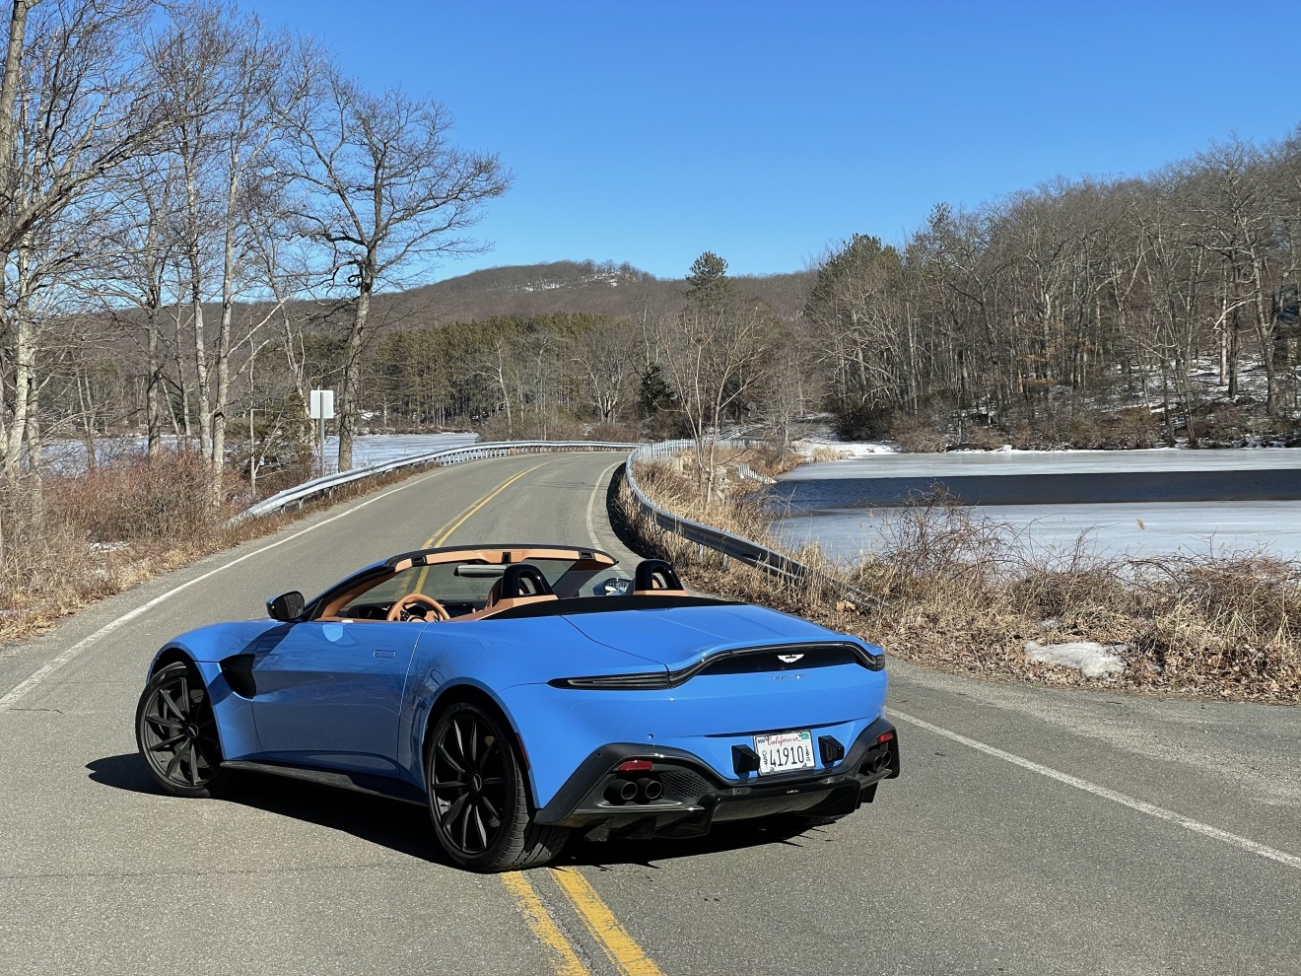
What is an Arbitrageur?
EXAMPLE: The James Bond of Car Dealerships.
Notes:
Here is a short background of my involvement as a market-maker and arbitrageur for the last decade or so.

Slide 9
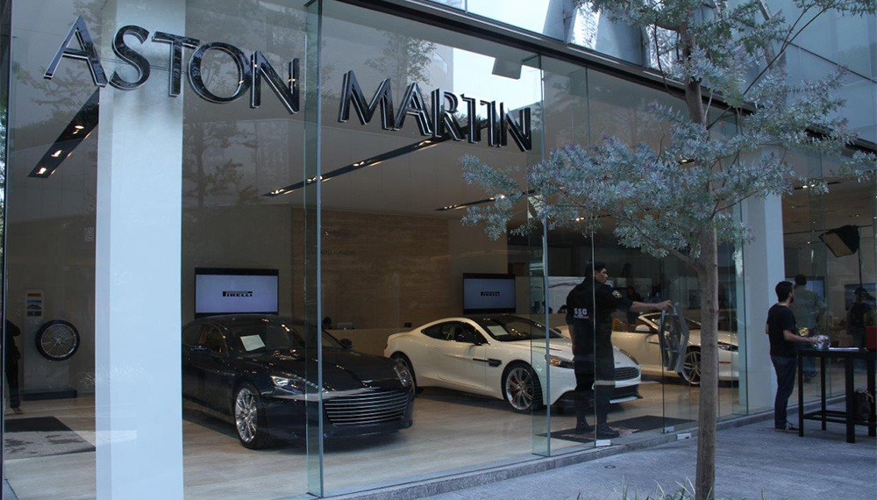
What Is an Arbitrageur?
What Is an Arbitrageur?
EXAMPLE: The James Bond of Car Dealerships
- Not a Financial Vehicle, but still a vehicle of Arbitrage.
Notes:
I will provide an example, in layman’s terms of how arbitrage exists – in a physical delivery market, rather an exchange.

Slide 10
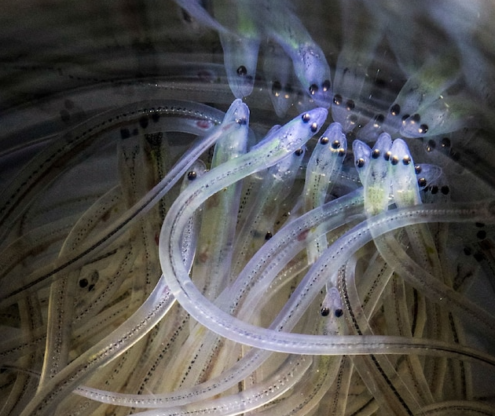
The glass-eel phenomenon
Notes:
The Antminer company, was one of the first to start selling “at home” mining kits, and with respect to their costs is generally there to assist the code/ program based traders to better mine their coins. I never purchased one of these myself.

Slide 11
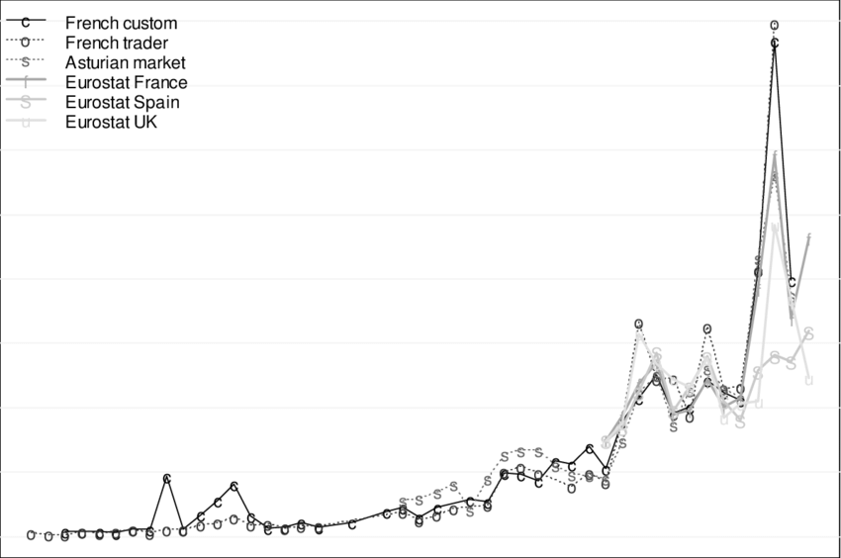
The glass-eel phenomenon
How Government and Politics become relevant when an economy booms.
- A catastrophe in Japan led to the export of “Elvers” which were NOT A DELICACY, however the supply in Japan was ruined (and will be for an extended period of time)
Notes:
The nuclear spill made it impossible for Japan to farm those elvers for about 100 years.

Slide 12
The glass-eel phenomenon
How the locals react…
“Short and sweet” is how Darrell Young, co-director of the Maine Elver Fishermen’s Association, put it when asked about the 2022 season. “This is the quickest we have ever filled our quota.”
The Waltham fisherman has fished for elvers for 30 years. He and several other fishermen collectively caught 80 pounds in eight days. He attributed the big catch to various factors including the Atlantic States Marine Fisheries Commission’s 2013 prohibition of harvesting of elvers at later stages of growth – when they are known as pigment, yellow and silver eels – along the Eastern Seaboard. The fact spring arrived early was another contributing factor.
The prices went from dollars, to thousands and sunk to $550 during Covid-19
- How do you think the locals felt about the future price of Elvers.
Notes:
https://www.mdislander.com/news/elvers-fetch-2-154-per-pound/article_b7b77c08-ba71-5ad6-a401-c75caaf11df1.html

Slide 13
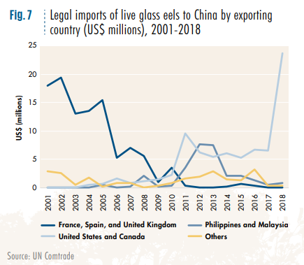
The glass-eel phenomenon
Notes:
https://www.unodc.org/documents/data-and-analysis/wildlife/2020/WWLC20_Chapter_7_Eels.pdf

Slide 14
Notes:
The arbitrage between competitors selling similar or identical products in different markets.

Slide 15
Notes:
The arbitrage between competitors selling similar or identical products in different markets, as fluctuations in price occur, the arbitrage opportunities become more substantial.

Slide 16
Crowded Spaces
Elvers fetch $2,154 per pound, and the area becomes crowded.
Real Estate Prices in Maine boom.
Politics in a small town in Maine.
The migration pattern of “Elvers” all of a sudden is a “thing of relevance”
The small town farmers all became millionaires, like they struck Gold.
In the United States, Maine’s elver fishery ranks among the most valuable on a per-pound basis. The baby eels are highly sought after in Japan, China and other Asian markets, where they are grown to market size. The translucent elvers also are a luxurious menu item – like caviar and truffles – in high-end restaurants around the globe.
https://www.europol.europa.eu/media-press/newsroom/news/glass-eel-traffickers-earned-more-eur-37-million-illegal-exports-to-asia
Notes:
The shift in demand outside Europe can be seen, for example, in export data on American glass eels. In the state of Maine, the catch quadrupled as prices increased twenty-fold in three years, from just under US$100 per pound (454g) in 2009 to just under US $2,000 per pound in 2012. The increase in both price and volume caused a sharp increase in the total market size in 2012 (Figure 8). In 2018, renewed demand for American eel was seen, albeit at lower prices, suggesting a competing source of supply…

Slide 17
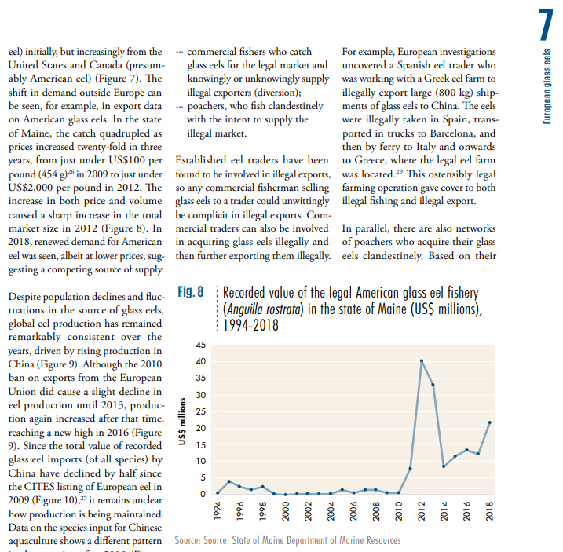
Notes:
The shift in demand outside Europe can be seen, for example, in export data on American glass eels. In the state of Maine, the catch quadrupled as prices increased twenty-fold in three years, from just under US$100 per pound (454g) in 2009 to just under US $2,000 per pound in 2012. The increase in both price and volume caused a sharp increase in the total market size in 2012 (Figure 8). In 2018, renewed demand for American eel was seen, albeit at lower prices, suggesting a competing source of supply…

Slide 18
Notes:
In 2014-2015, I coded and deployed a Bitcoin miner using a partition on my hard-drive and mined about two coins in roughly two months. > This of course, was when bitcoin was valued at roughly $350/BTC and I was generating anywhere from 5-50,000/ day. Everyday.

Slide 19
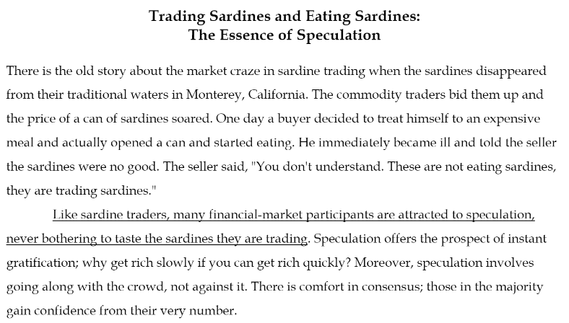
The Story of Trading Sardines
Seth Klarman’s Theories in “Margin of Safety”
Notes:
The difference between assets you keep on the shelf, and those you want to consume.
- Not limited to commodities, but for example – when you take an asset off the shelf and decide you want to sell it. - it may not taste as good when you decide to execute and turn your assets into cash for reinvestment.

Slide 20
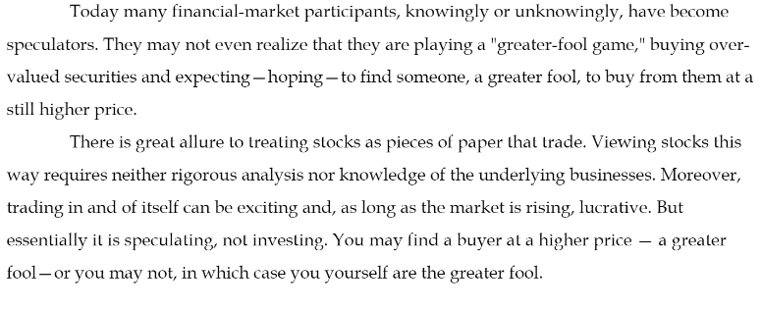
The Story of Trading Sardines
Seth Klarman’s Theories in “Margin of Safety”
Notes:
The difference between assets you keep on the shelf, and those you want to consume.
- Not limited to commodities, but for example – when you take an asset off the shelf and decide you want to sell it. - it may not taste as good when you decide to execute and turn your assets into cash for reinvestment.

Slide 21
mining VS. trading
Bitcoin and Cryptocurrency
Notes:
The difference between assets you harvest, which eventually need to be sold, or traded. - one way or the other, you must harvest the information and make sure you are getting the best product at the best price.

Slide 22
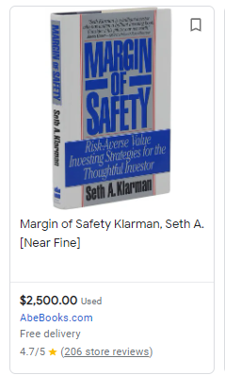
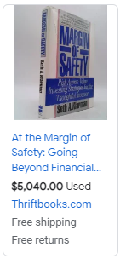
A TEXTBOOK EXAMPLE OF ARBITRAGE
Notes:
Are these two books the same.

Slide 23
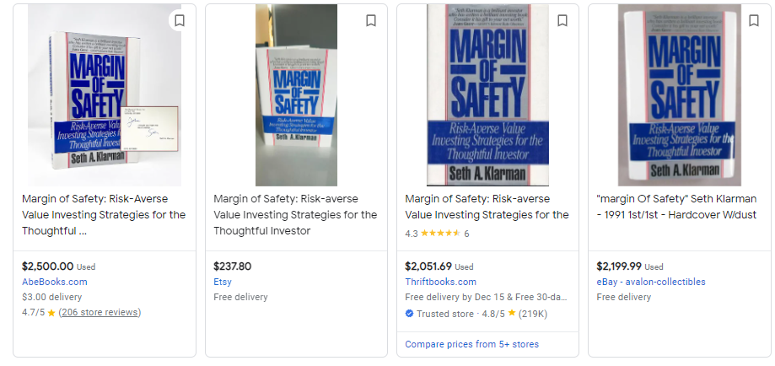
Notes:
Are these books the same? - Depends on who you are asking.

Slide 24
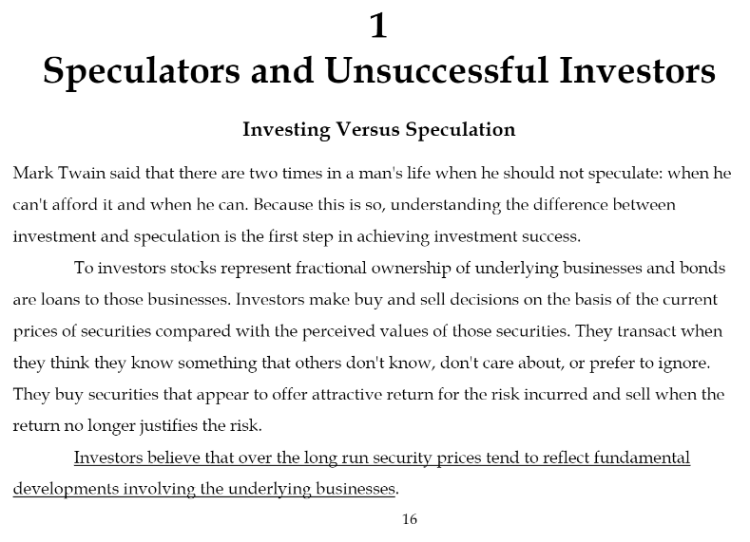
Illegal vs. Legal Arbitrage
Notes:
Speculation, should be limited in the scope of arbitrage; in fact – it should not exist, there should be no question as to “ AM I GOING TO MAKE MONEY “ on this transaction.

Slide 25
Illegal vs. Legal Arbitrage
Speculation, should be limited in the scope of arbitrage; in fact – it should not exist.
There should be no question as to “AM I GOING TO MAKE MONEY”
- or it is not a true arbitrage which is in the later slide that I will show you.
Notes:
Speculation, should be limited in the scope of arbitrage; in fact – it should not exist, there should be no question as to “ AM I GOING TO MAKE MONEY “ on this transaction.

Slide 26
What Is an Arbitrageur?
What Is an Arbitrageur?
EXAMPLE: The James Bond of Car Dealerships
- Not a Financial Vehicle, but still a vehicle of Arbitrage.
Notes:
When arbitrage exists – in any market. There is no question of “am I going to make a profit”.

Slide 27
Bitcoin Mining Procedure
Cryptocurrency Wallet
Mining Software
Mining Hardware
Notes:
You'll need a cryptocurrency wallet, mining software, and mining hardware to begin mining cryptocurrency. The equipment you need can be very expensive; however, the more you pay for equipment, the more profitable it can be.

Slide 28
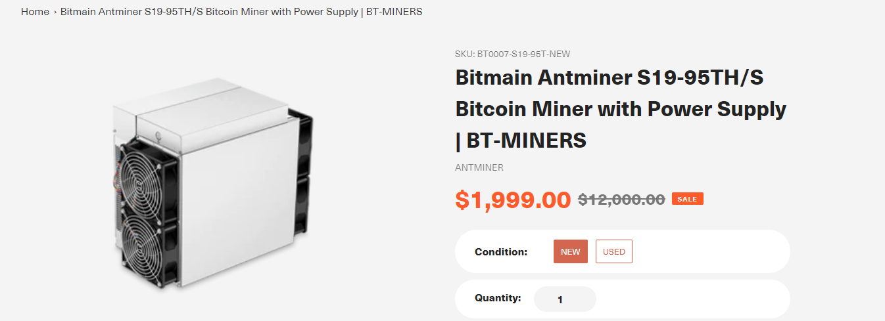
ANTMINER
Notes:
The Antminer company, was one of the first to start selling “at home” mining kits, and with respect to their costs is generally there to assist the code/ program based traders to better mine their coins.
- I never purchased one of these myself, and never needed to. - Generally what happens is, they are built to spec and in some cases, you will earn your money back before they become obsolete. - As new devices with more CPU speed arrive to market, you generally see the prices on the older ones come down, no different than a late model Ford Mustang.

Slide 29
What is an Antminer?
Notes:
- I never purchased one of these myself, and never needed to. So my advice is if you are thinking of purchasing one of these just give me the money instead. - Generally what happens is, they are built to spec and in some cases, you will earn your money back before they become obsolete. - As new devices with more CPU speed arrive to market, you generally see the prices on the older ones come down, no different than a late model Ford Mustang.

Slide 30
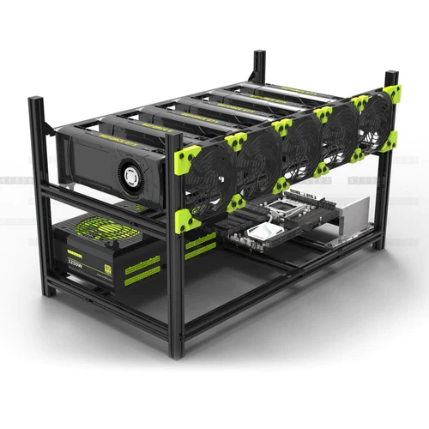
What is an Antminer?
The barrier of entry using the hardware approach is no different than buying an office building to rent out all of the offices so you can have a free office.
Basically, if all you want is an office, just get the office and you can make just as much money without having to maintain an entire building.
Notes:
You'll need a cryptocurrency wallet, mining software, and mining hardware to begin mining cryptocurrency. The equipment you need can be very expensive; however, the more you pay for equipment, the more profitable it can be.
The barrier of entry using the hardware approach is no different than buying an office building to rent out all of the offices so you can have a free office.
Basically, if all you want is an office, just get the office and you can make just as much money without having to maintain an entire building.

Slide 31
Bitcoin Mining Procedure
Cryptocurrency Wallet
Mining Software
Mining Harware
Notes:
You'll need a cryptocurrency wallet, mining software, and mining hardware to begin mining cryptocurrency. The equipment you need can be very expensive; however, the more you pay for equipment, the more profitable it can be.

Slide 32
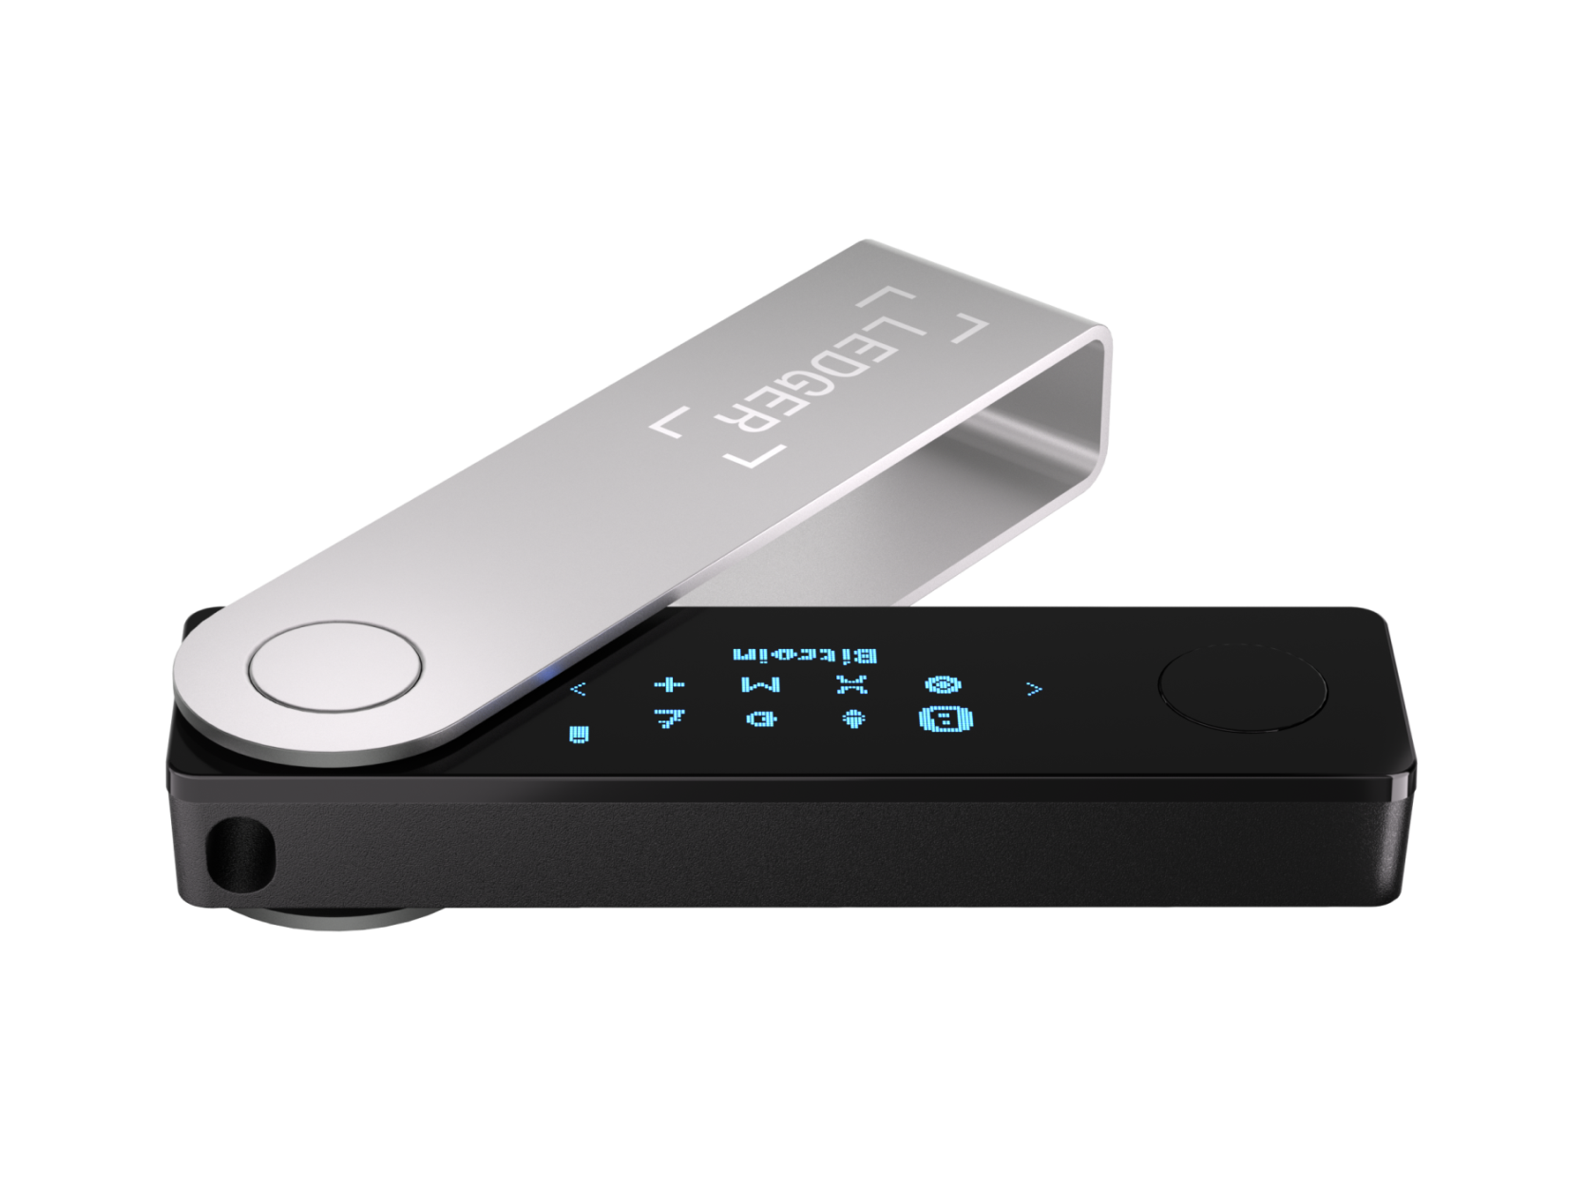
Bitcoin Mining
Notes:
Cryptocurrency Wallet, to store the Bitcoins, or whatever cryptocurrency you are interested in mining.
Mining Software, which we will walk about a little later.
Mining Hardware, like the Antminer, or other ways you can configure your CPU, GPU, and PC/ or laptop to network in P2P mining.

Slide 33
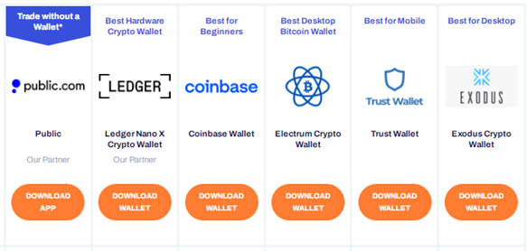
Bitcoin Wallets
Notes:
You'll need a cryptocurrency wallet, mining software, and mining hardware to begin mining cryptocurrency. The equipment you need can be very expensive; however, the more you pay for equipment, the more profitable it can be.
It doesn’t make that big of a difference of which wallet you are using. - typically you are just pointing whatever mining software you are using to point your earning into a digital wallet somewhere.

Slide 34
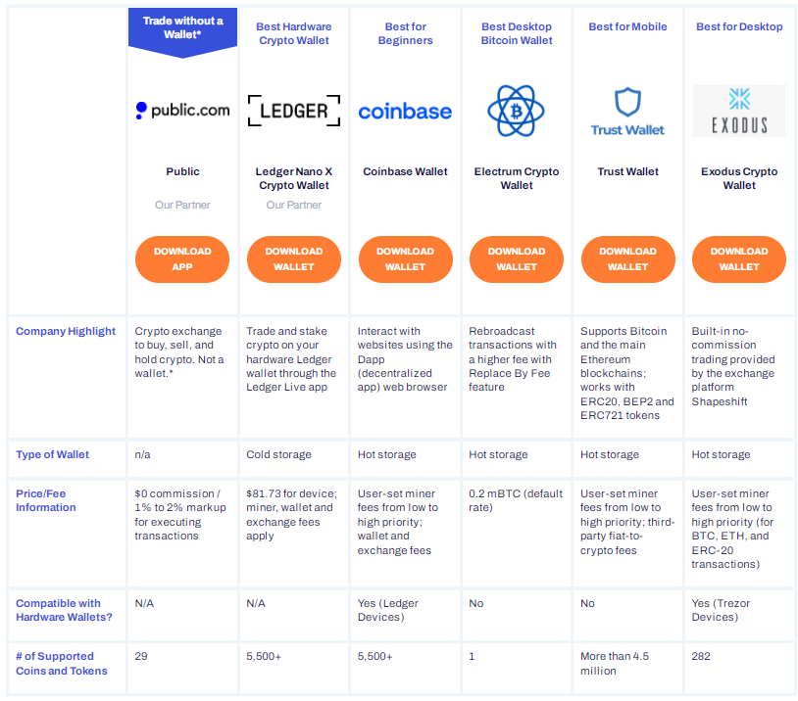
Bitcoin Wallets
Notes:
It doesn’t make that big of a difference of which wallet you are using. - typically you are just pointing whatever mining software you are using to point your earning into a digital wallet somewhere.

Slide 35
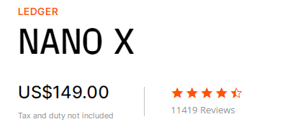
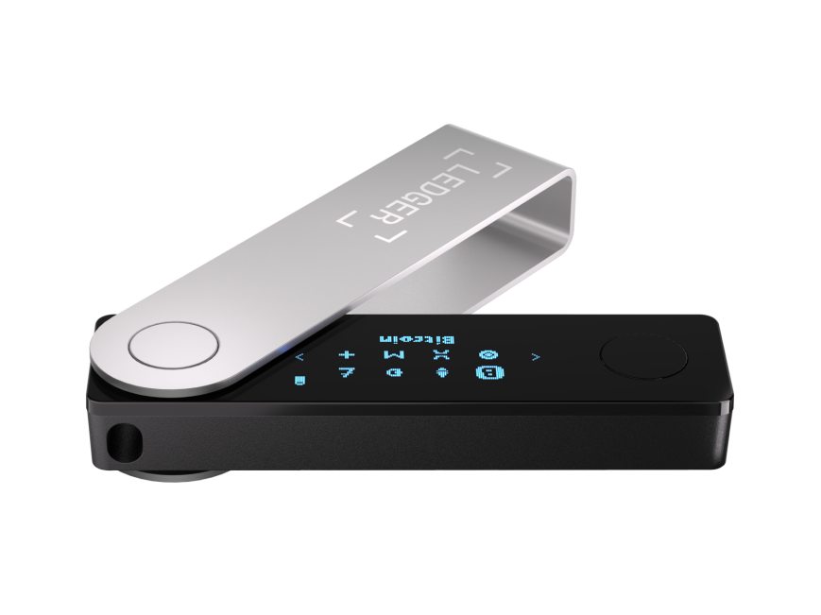
Bitcoin Wallets
Notes:
Waste of money, don’t pay for what you don’t need unless you just want to show off.

Slide 36
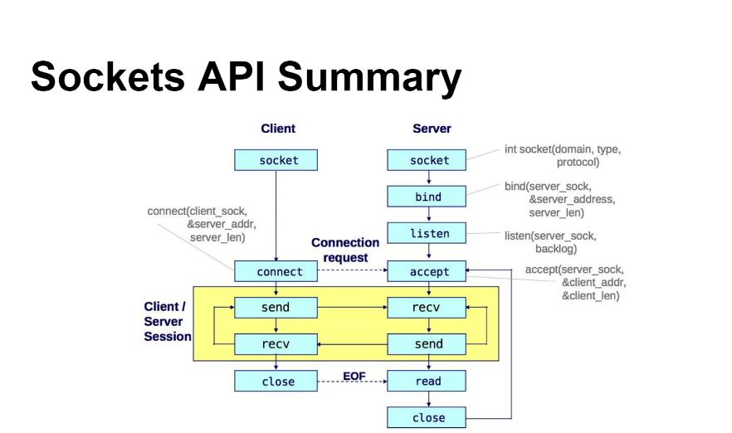
P2P negotiation cycles in the cloud.
Notes:
Explain how this and mining in a p2p environment are one-in-the-same on the white board.

Slide 37
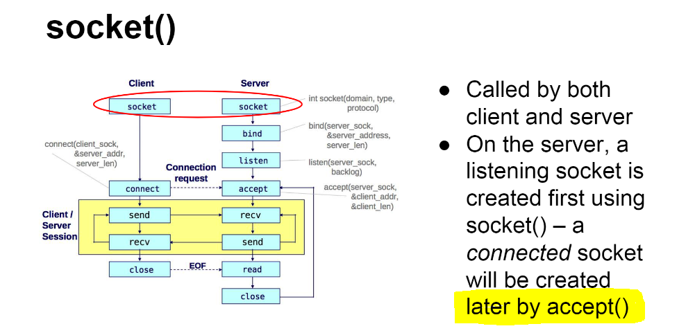
You wait in a queue until your machine has solved the hash
Notes:
Explain how this and mining in a p2p environment are one-in-the-same on the white board.

Slide 38
Program Trading: Financial Information Exchange
FIX 4.x, using quickfix/1.15.1
Introduction to what is ahead.
Notes:
quickfix/1.15.1

Slide 39
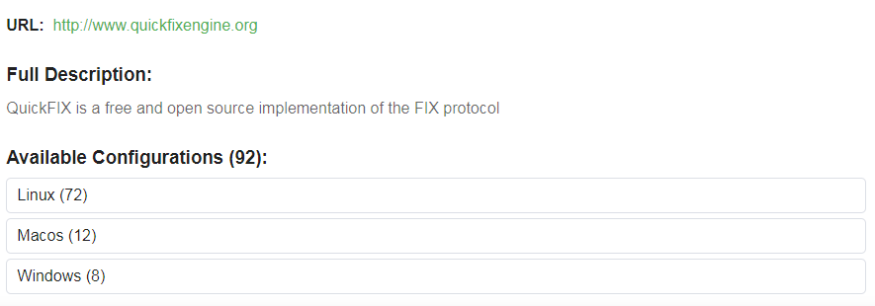
Program Trading: Financial Information Exchange
Notes:
quickfix/1.15.1

Slide 40
Step-by-step how to set up a fix engine on your PC
Notes:
The interactive brokers fix engine.

Slide 41
Program Trading: Cryptocurrency Smart Contracts
Different API solutions offered in the market.
The interactive brokers fix engine.
Step-by-step how to set up a fix engine on your laptops.

Slide 42
Program Trading: Smart Contracts - Day II: how to use the FIX information exchange
Cryptocurrency
Equities
Fixed Income
Derivatives
Futures
Commodities
Notes:
We are going to review how to obtain, store, and use Crypto coding with C++
https://conan.io/center/quickfix?os=Windows&tab=overview

Slide 43
Program Trading: Smart Contracts, FIX tags. - https://www.onixs.biz/fix-dictionary/4.2/fields_by_tag.html - https://quickfixengine.org/c/documentation/
Notes:
How to use regression strategies to identify arbitrage
- And the similarities.

Slide 44
Program Trading: Smart Contracts, FIX tags. - Day II: Regression strategies to identify arbitrage
Cryptocurrency
Equities
Fixed Income
Derivatives
Futures
Commodities
Notes:
How to use regression strategies to identify arbitrage
- And the similarities.

Slide 45
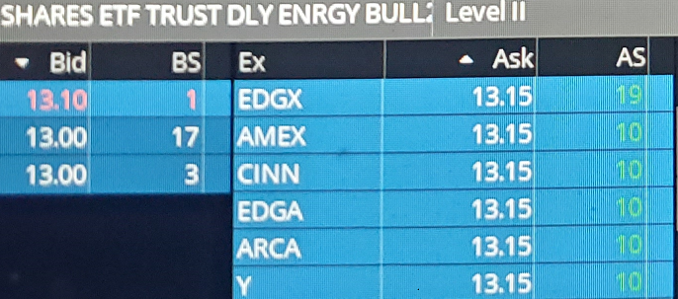
Program Trading: Market Making. - Day II: How to observe supply and demand to determine values.
Working with the stack.
How to “melt” an iceberg order.
Notes:
How to use regression strategies to identify arbitrage
Explain what this means, and how to melt an iceberg.
Do this example of the whiteboard to explain how the stack can be manipulated as an aggressor and as a liquidity provider.

Slide 46
Program Trading: Arbitrage. - Day II: How to observe bid & ask price arbitrage.
Working with the stack to identify arbitrage.
How to “intelligently” execute an arbitrage order.
Notes:
How to use regression strategies to identify arbitrage
Explain market depth.
Do this example of the whiteboard to explain how the stack can be manipulated as an aggressor and as a liquidity provider.

Slide 47
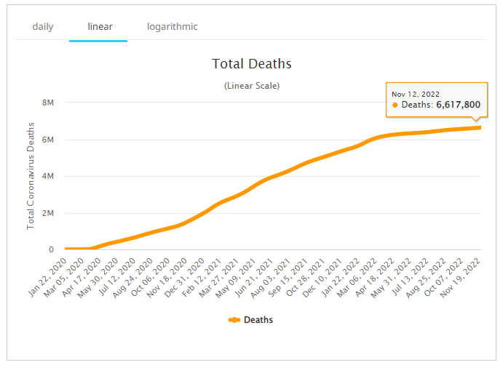
Program Trading: Forecasting Values. - Day II: How to use regression strategies to forecast values.
Notes:
How to use regression strategies to identify arbitrage
- And why they are all the same.

Slide 48
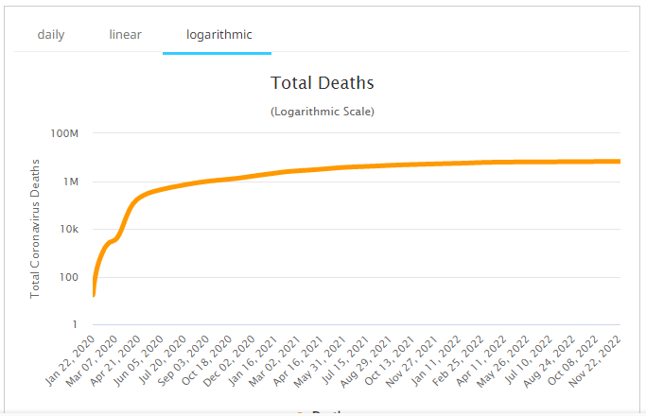
Program Trading: Forecasting Values. - Day II: How to use regression strategies to forecast values.
Notes:
How to use regression strategies to identify arbitrage
- And why they are all the same.

Slide 49
Program Trading. - Day II: How to use regression strategies to forecast values.
https://covid.ourworldindata.org/data/owid-covid-data.xlsx
This table has about 250,000 rows of information which we will use to forecast deaths in each country.
No matter which country you select, your program should be able to pin the number of deaths in the future.
Notes:
How to use regression strategies to identify arbitrage
- And why they are all the same.

Slide 50
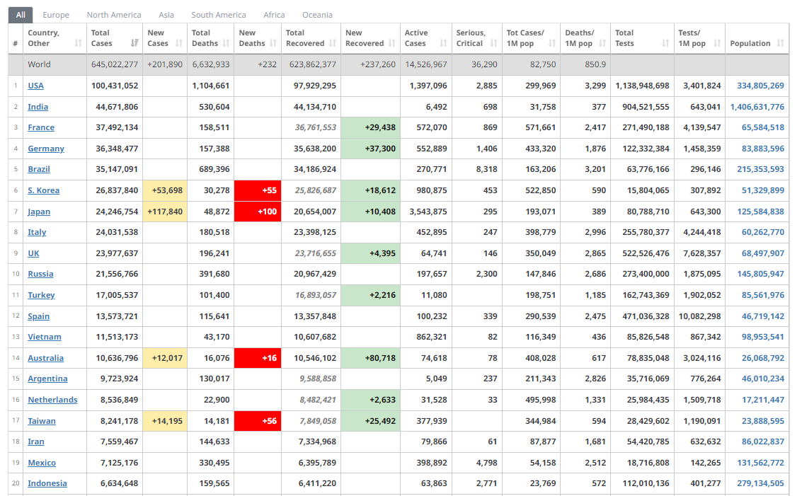
Program Trading. - Day II: How to use regression strategies to forecast values.
Notes:
How to use regression strategies to identify arbitrage
- And why they are all the same no matter what information you are trying to forecast, as long as there are enough data points in the past.

Slide 51
Program Trading - Day II: ETL Strategies using Memory Mapped Files
Flat file storage solutions
The advantages over SQL, Mongo, or anything.
Notes:
Discuss the in-depth process of ETL on the whiteboard using flat file storage solutions and its advantages over SQL, Mongo, or anything.

Slide 52
Program Trading - Day II: ETL Strategies using Memory Mapped Files
Extract
Transform
Load
Notes:
Discuss the in-depth process of ETL on the whiteboard using flat file storage solutions and its advantages over SQL, Mongo, or anything.

Slide 53
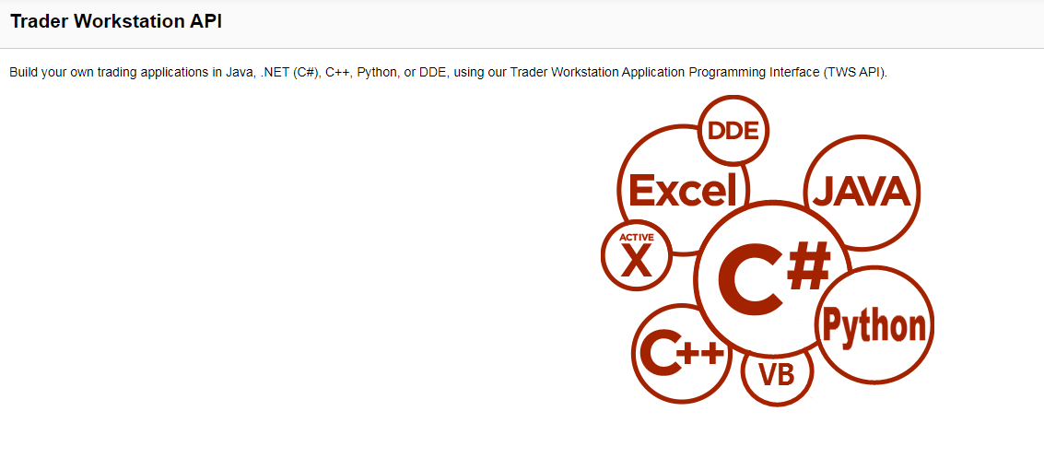
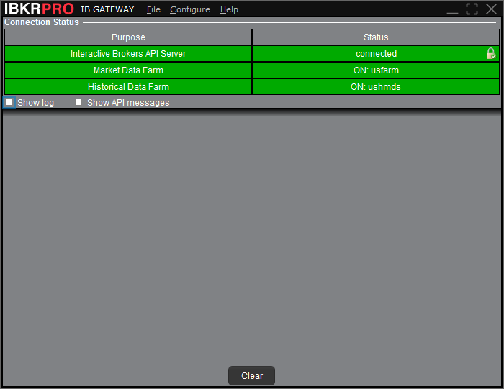

Slide 54
https://www.interactivebrokers.com/en/trading/tws-offline-installers.php
https://www.interactivebrokers.com/en/trading/ibgateway-latest.php

Slide 55
https://www.interactivebrokers.com/en/trading/tws-offline-installers.php
https://www.interactivebrokers.com/en/trading/ibgateway-latest.php
The API Stable for Windows includes the Java, C++, C#/.NET, ActiveX, and DDE APIs, along with sample code and spreadsheets. The API Latest for Windows (v1014) additionally includes the Python API.
The API Stable for Mac/Unix (v976) includes the Java and Posix C++ API source and sample. The API Latest for Mac/Unix (v1014) additionally includes the Python API. (Excel APIs are only available on Windows)

Slide 56
Program Trading: Smart Contracts - 12/7: Crypto coding with C++

Slide 57
Program Trading: Smart Contracts - 12/8: Crypto coding with C++

Slide 58
Program Trading: Smart Contracts - 12/9: Crypto coding with C++

